Slide 1
What is Golazo?
Lightweight process for ~4-10 engineers
Small batches with visible status
Key artifacts
Tickets
Design documents
Board
Touchpoints

Slide 2
Clarify Together
Build Small
Streamline Reviews
Share Learnings

Slide 3
Pain | Golazo Practice
Late rework | Early design docs
Slow feedback | Small visible tickets
Silos | Anyone pulls Ready work
Multitasking | Work In Progress limits
Bug churn | Validation stage
Boring standups | Share learnings and unblock

Slide 4
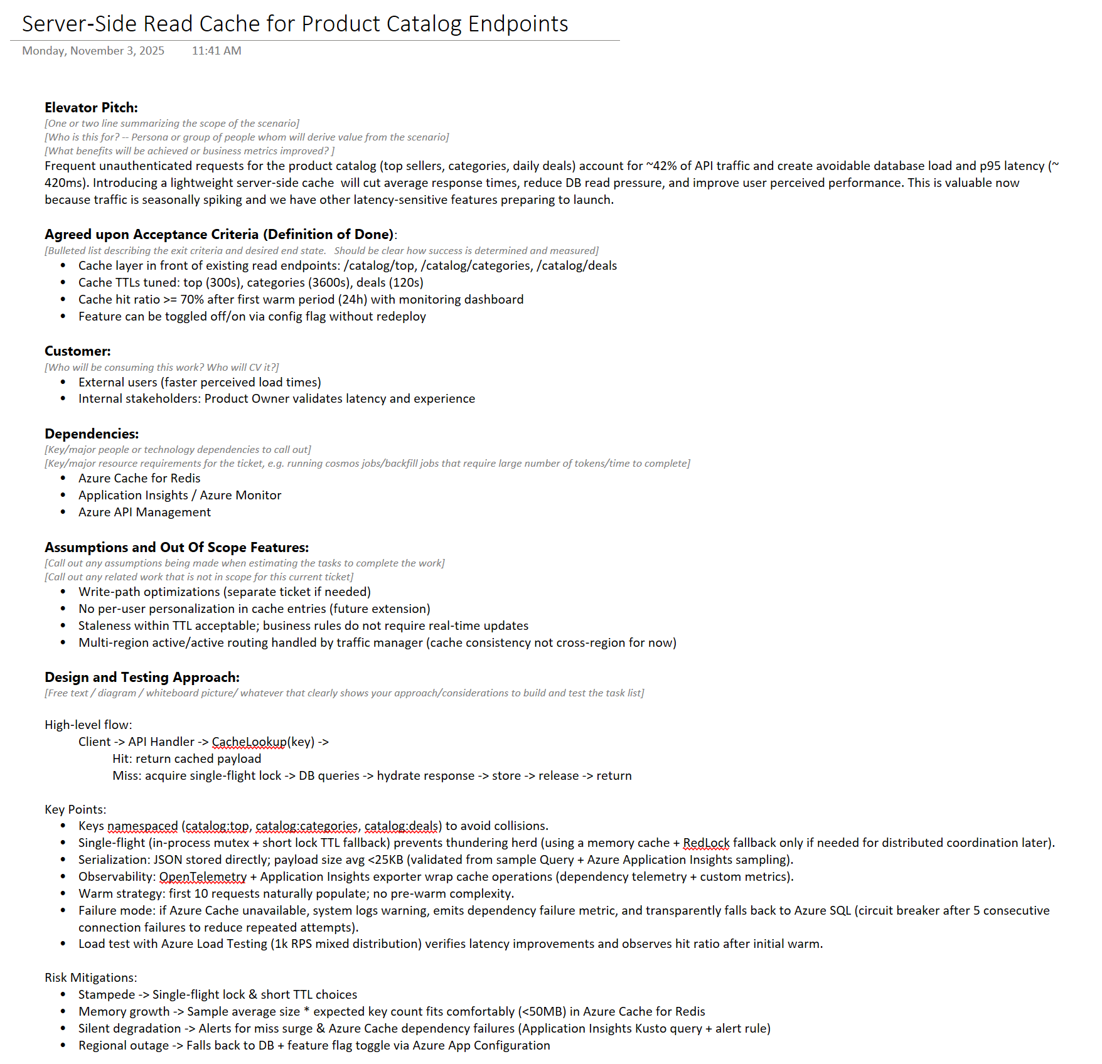

Slide 5
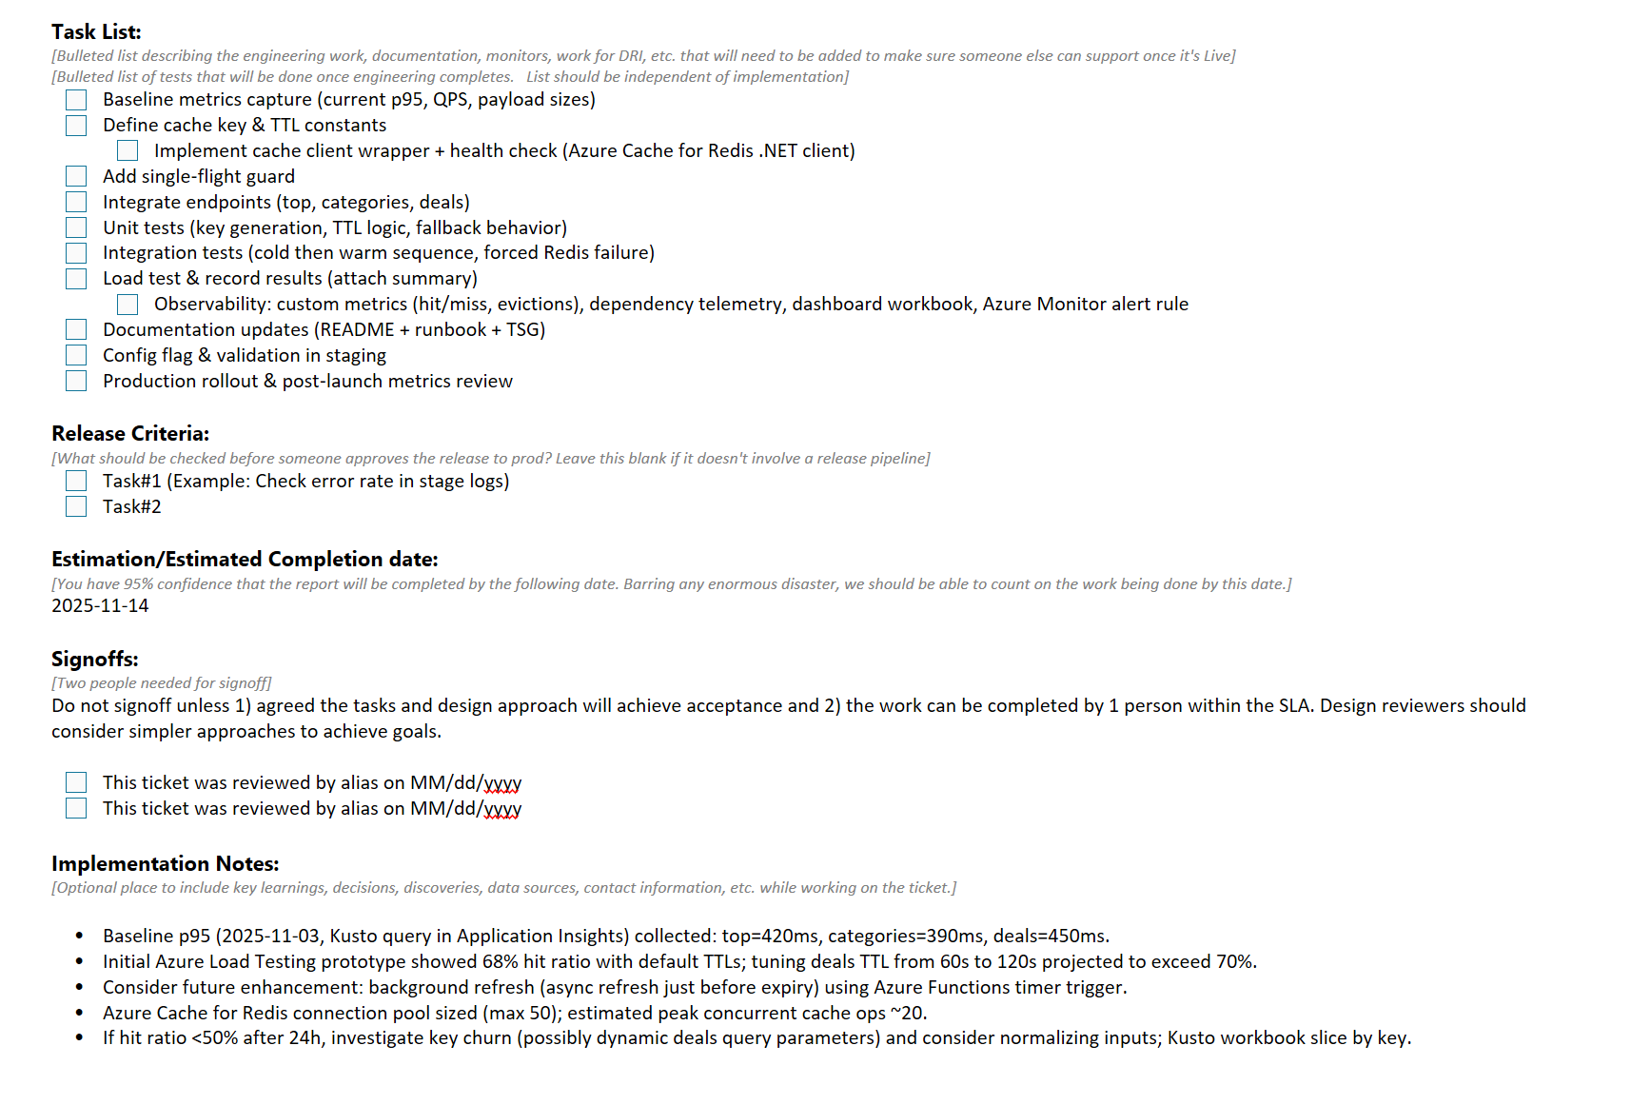

Slide 7
 | Backlog | Ready | Analyze |  | Engineer |  | Release | Customer Validation | Done
 |  |  | Doing | Review | Doing | Review
SWARM
Interrupt
Planning

Slide 8
Work in Progress (WIP) Limit
A deliberate cap on the number of active, unfinished items a team or person may have at once

Slide 9
Column WIP: 3
Column WIP: 4
 | Backlog | Ready | Analyze |  | Engineer |  | Release | Customer Validation | Done
 |  |  | Doing | Review | Doing | Review
SWARM
Interrupt
Planning
Rail WIP: 1

Slide 10
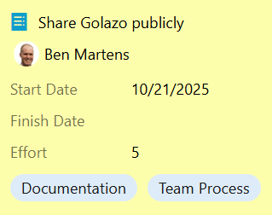
Small Tickets, Big Value
Clear user value
< 2 weeks
Validation plan
Ready to start

Slide 11
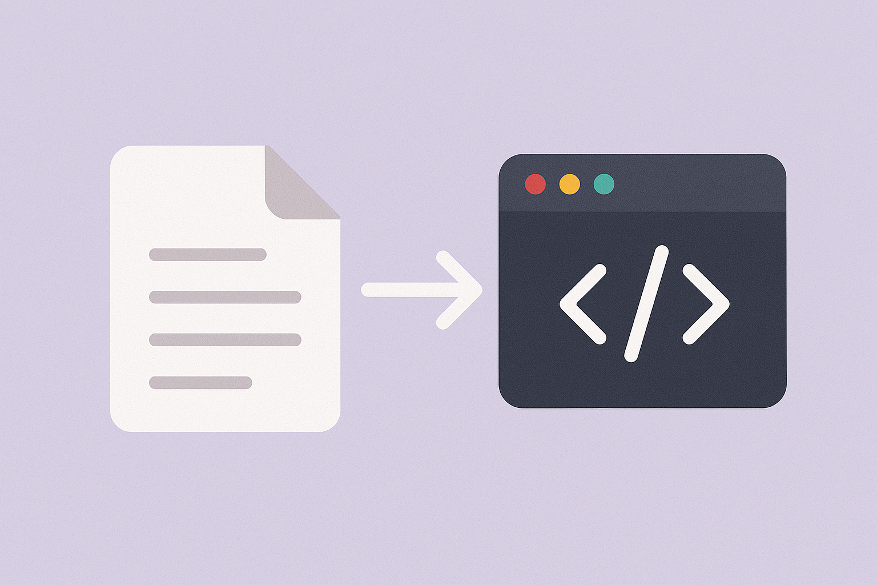
Refined Reviews
Alignment earlier = smaller review scope
Focus on correctness and clarity
Invites diverse skillsets
Spreads knowledge

Slide 12

Observed Value
Must observe real outcome
Examples: usage, metrics, signoff
Visualize tickets moving backwards when needed
Ship impact, not artifacts

Slide 13

Collaboration
Pick any ticket from any workstream
Encourage pairing to unblock and teach
Foster inclusive conversations
Turn observers into contributors

